Slide 1
Introduction to Unsupervised Machine Learning
Soumya Banerjee

Slide 2
Warm up
You have a 5-liter jug and a 3-liter jug. How can you measure exactly 4 liters of water using only these two jugs?

Slide 3
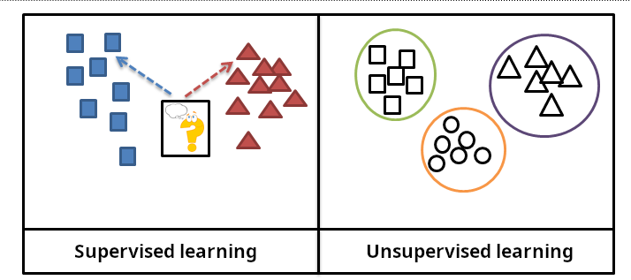
Types of Machine Learning
Slide courtesy Paul Fannon

Slide 4
Supervised Learning - Regression
Student | ML Trained? | Cohort %ile | Salary
0001 | Y | 12 | 120000
0002 | Y | 58 | 42000
0003 | N | 22 | 36000
0004 | Y | 58 | 35000
… | … | … | …
1784 | Y | 34 | ???
Slide courtesy Paul Fannon

Slide 5
Unsupervised methods
History
Exploratory data analysis
Hypothesis generation
Data visualization
Data imputation
Detecting outliers
Reduce “dimensions” or ”features”
Notes:
Slide on single-cell rna seq tsne xx
Slide on bulk seq data

Slide 6
High-dimensional data
How to visualize high-dimensional data?
Pairwise

Slide 7

High-dimensional data
https://stats.stackexchange.com/questions/2691/making-sense-of-principal-component-analysis-eigenvectors-eigenvalues

Slide 8
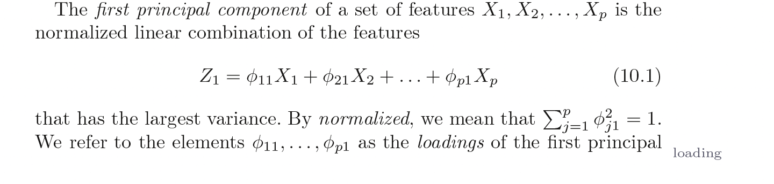
PCA
Introduction to Statistical Learning in R

Slide 9
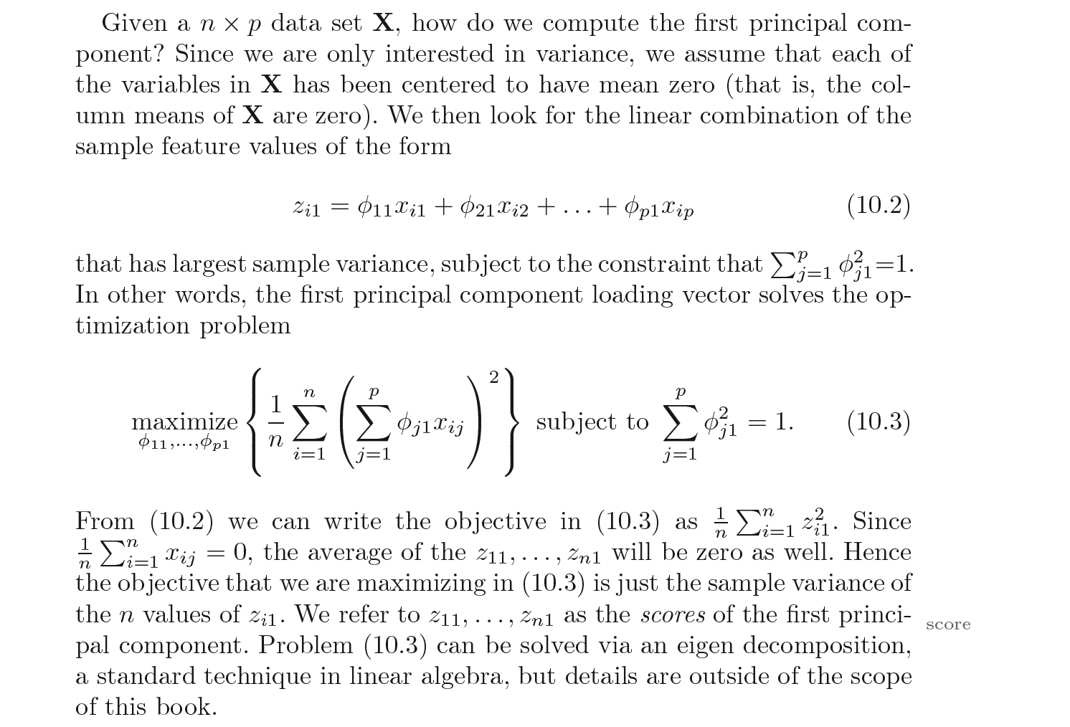
PCA
Introduction to Statistical Learning in R

Slide 10
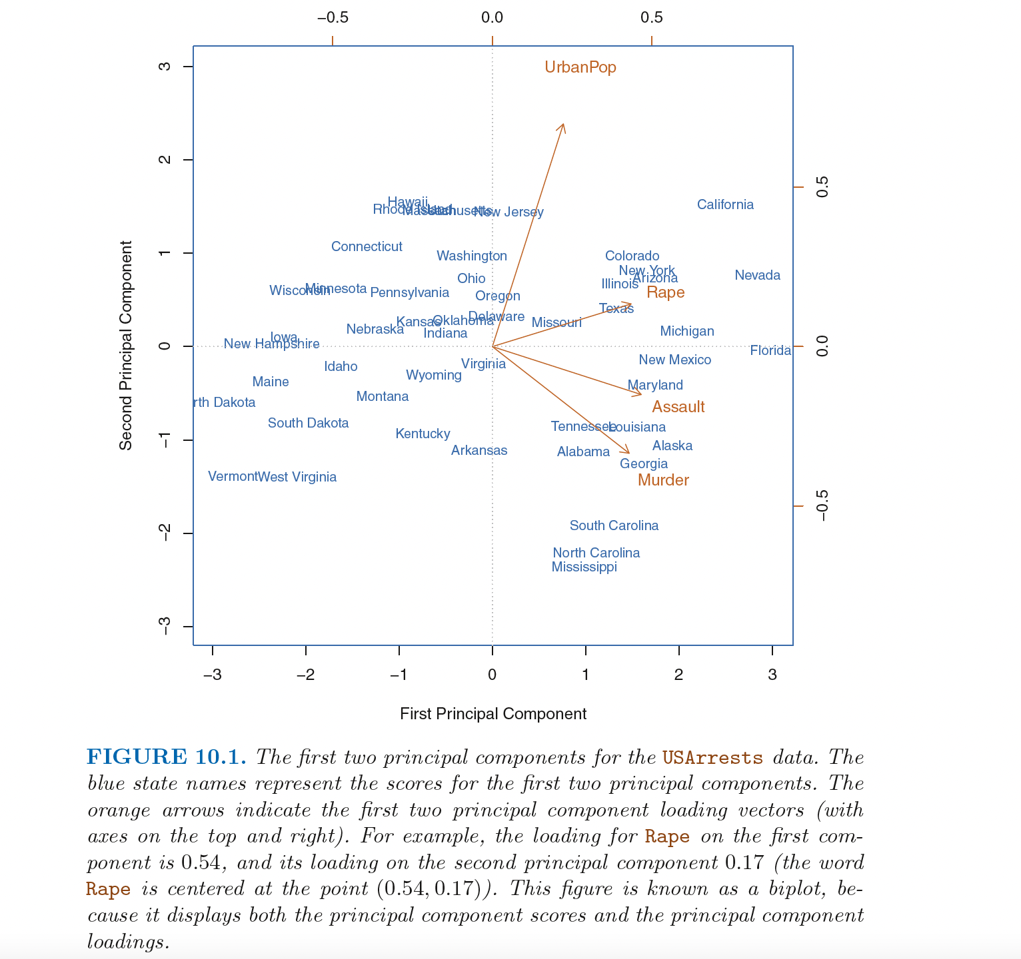

Slide 11
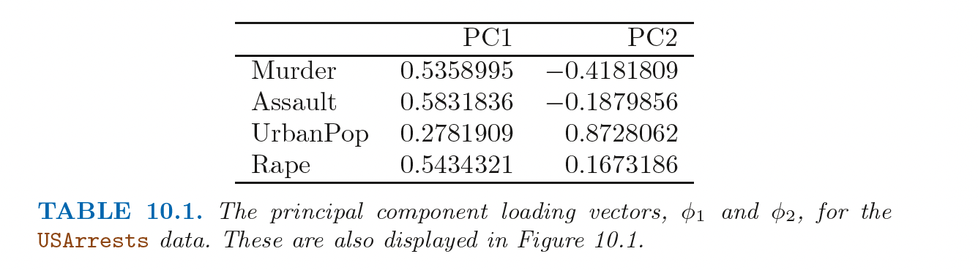
PCA
Introduction to Statistical Learning in R

Slide 12
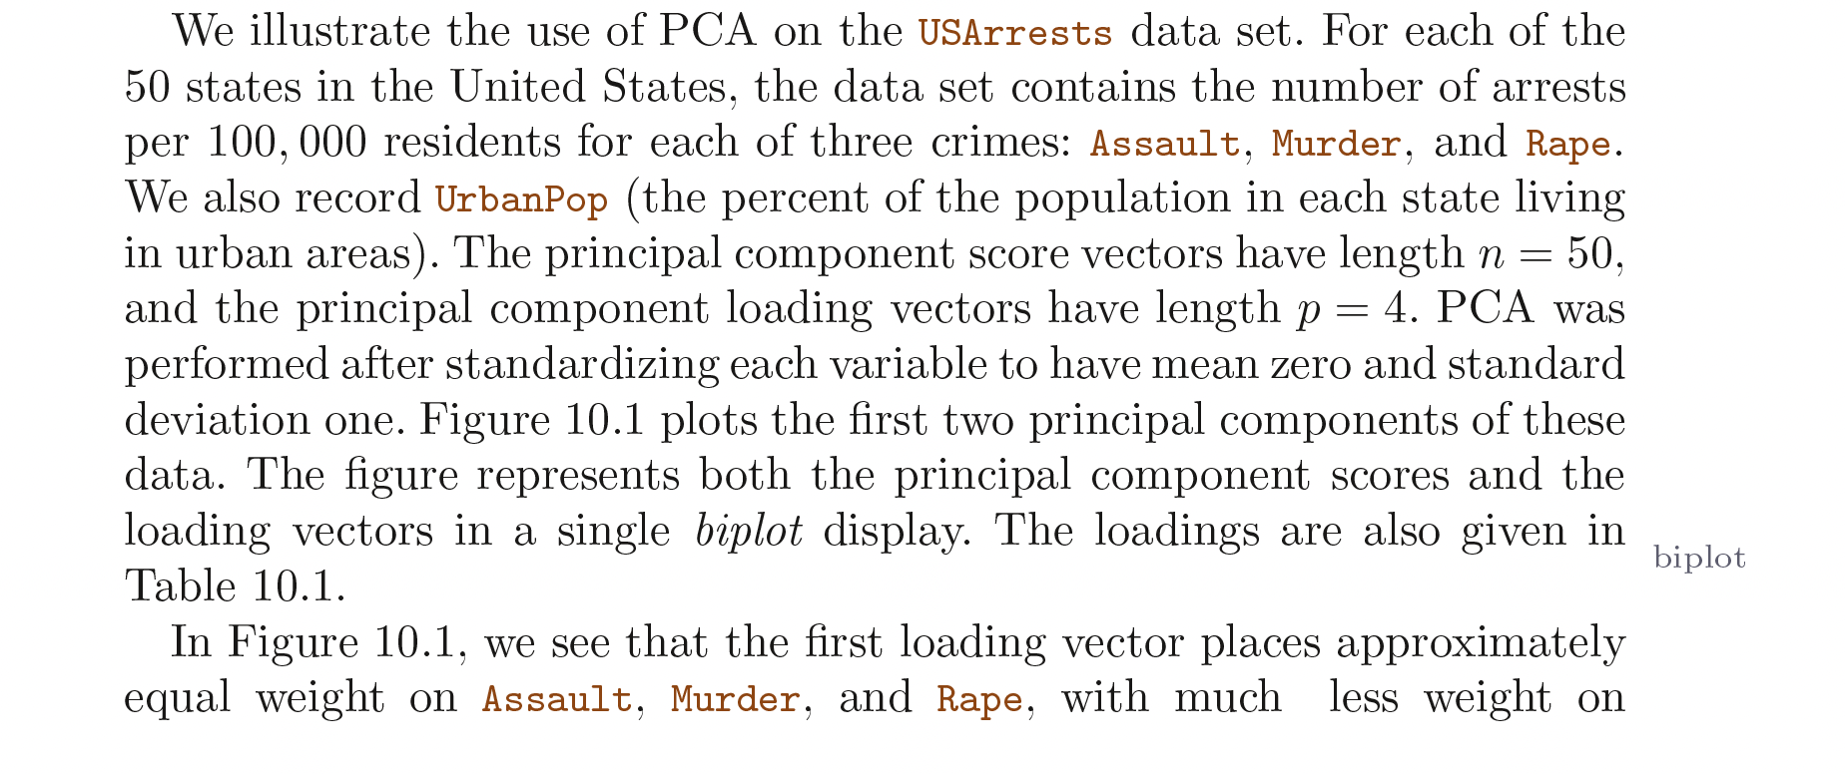
PCA
Introduction to Statistical Learning in R

Slide 13
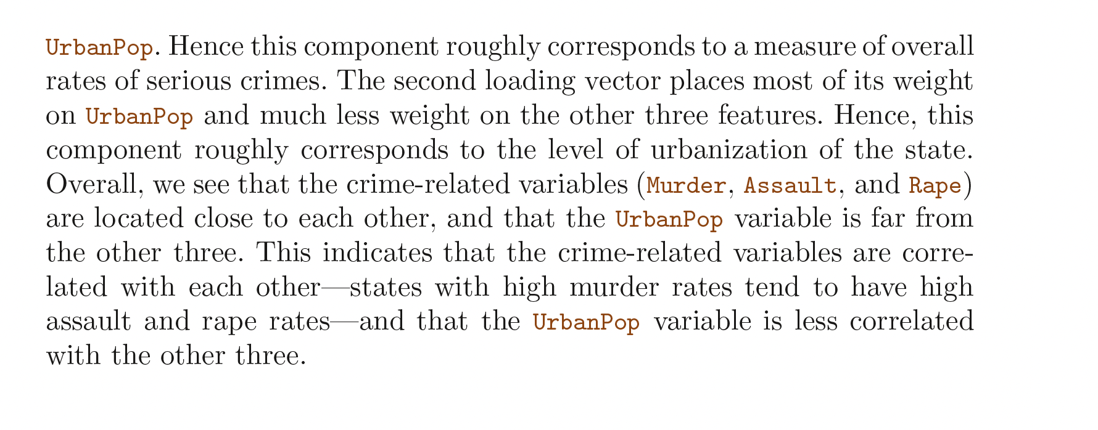
PCA
Introduction to Statistical Learning in R

Slide 14
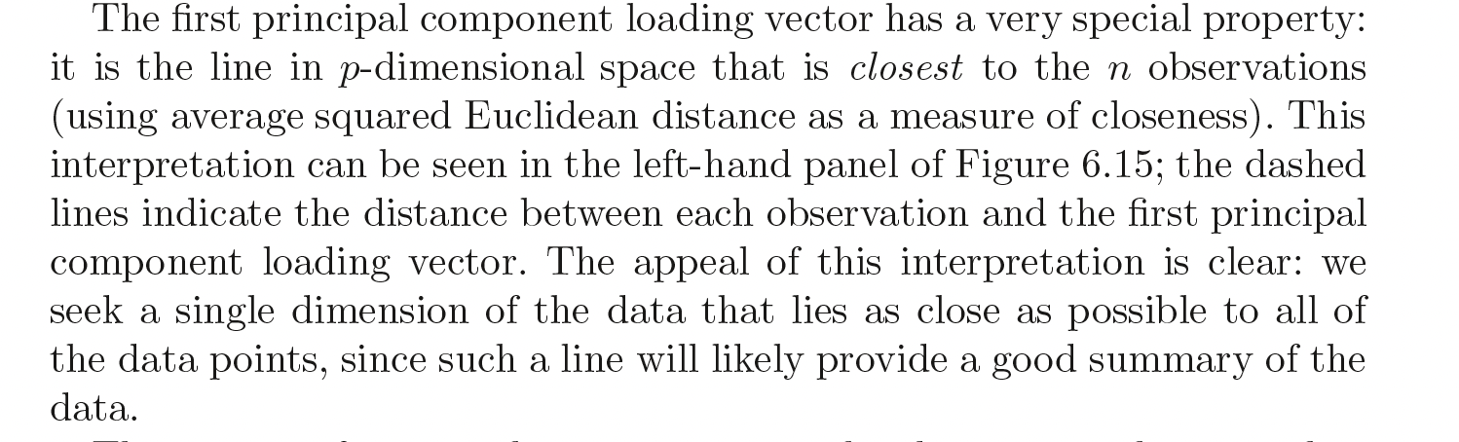
PCA
Introduction to Statistical Learning in R

Slide 15
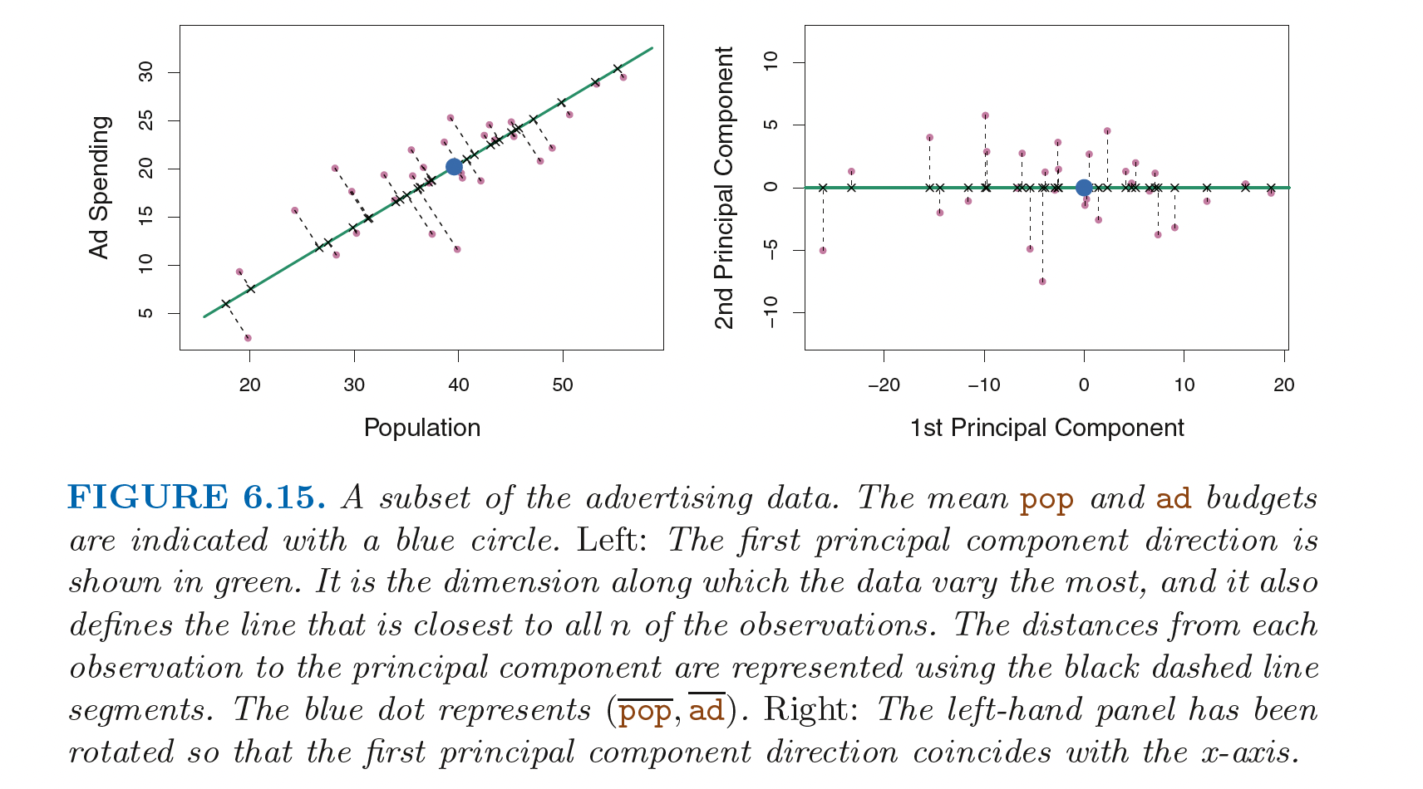
PCA
Introduction to Statistical Learning in R

Slide 16
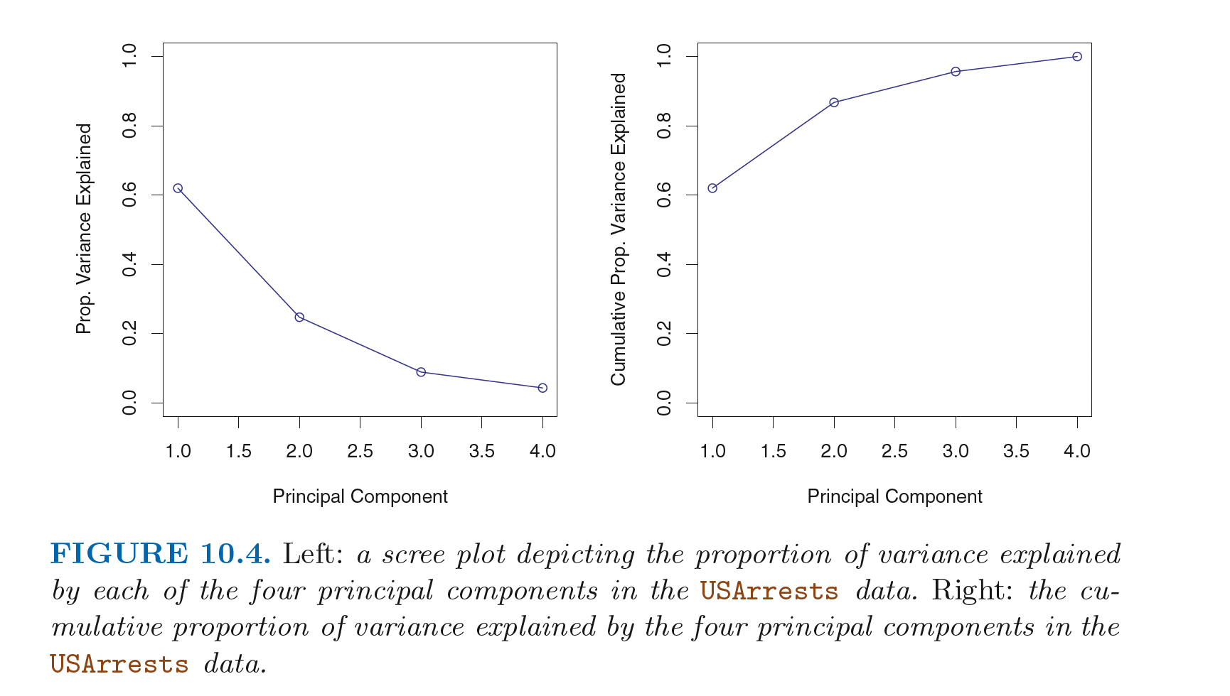
Scree plots (PRACTICAL)
Introduction to Statistical Learning in R

Slide 17
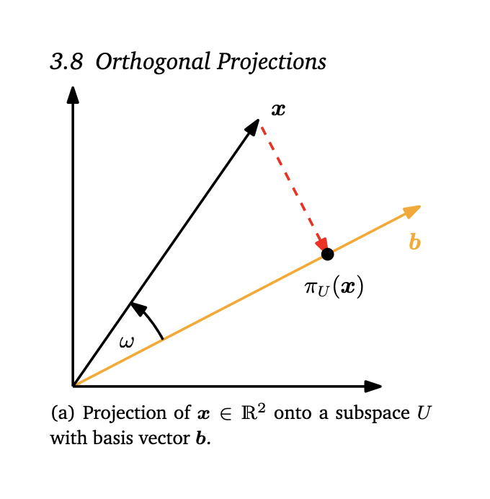
Theory

Slide 18
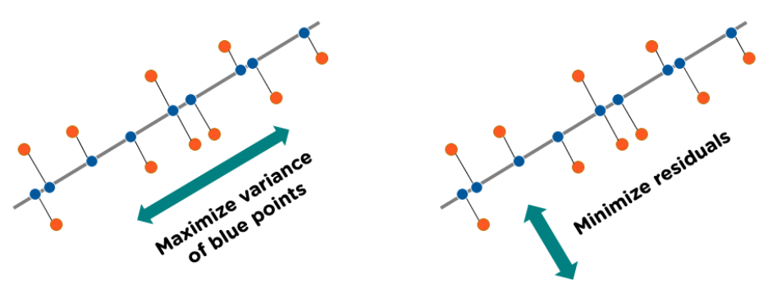
Concept
https://www.simplilearn.com/tutorials/machine-learning-tutorial/principal-component-analysis

Slide 19
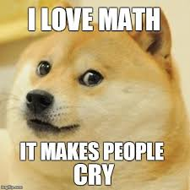
Math!

Slide 20
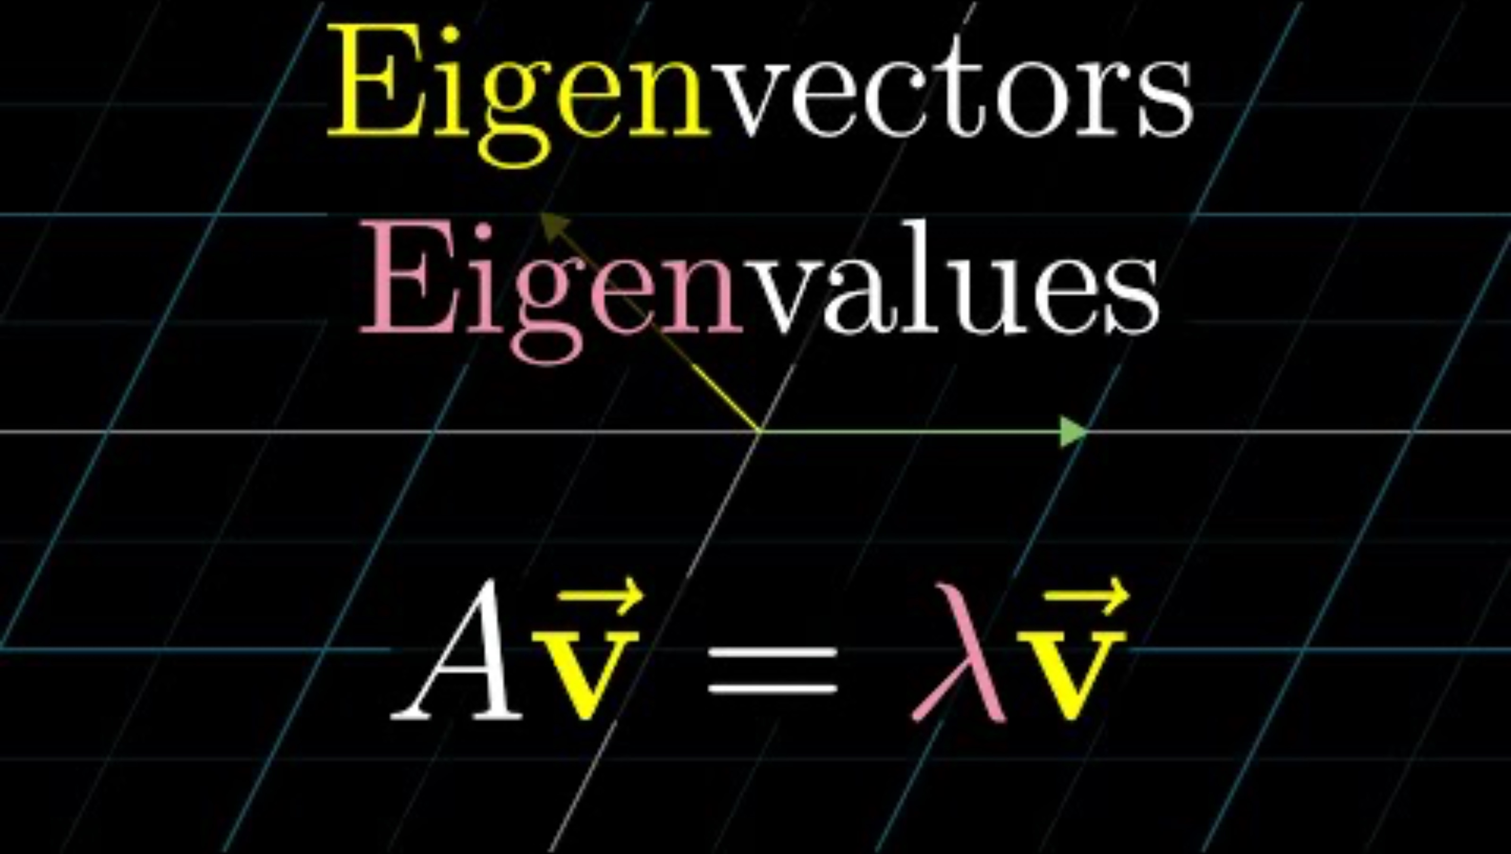
Intuition

Slide 21
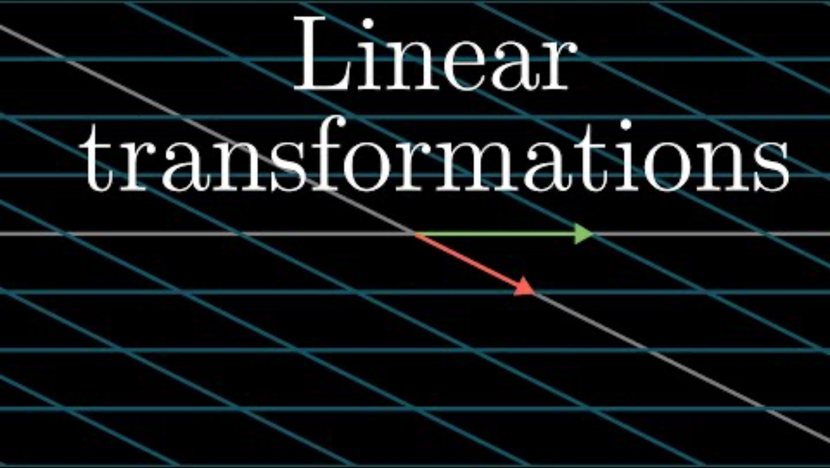
Matrices as linear transformations

Slide 22

Interactive tool
https://projector.tensorflow.org/

Slide 23
Non-linear
How to make a non-linear dimensionality reduction technique?

Slide 24

Important concept
Information bottleneck
Notes:
This is how you achieve word embedding

Slide 25
generalizations of this idea
tSNE
Autoencoder (non-linear loss function)

Slide 26
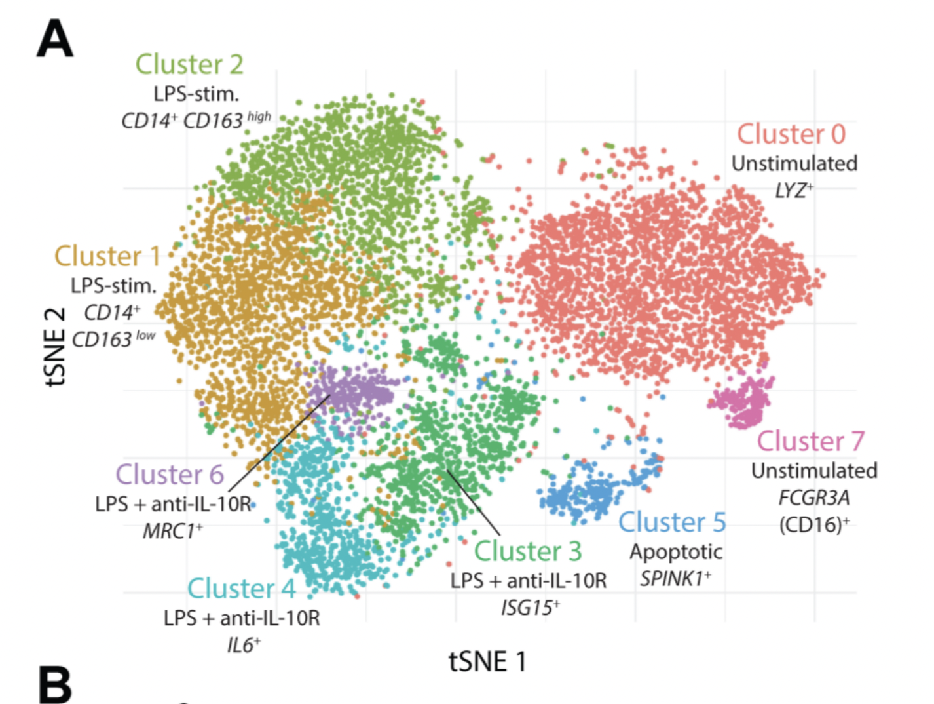
Case study
a. stochastic b. distances not preserved c. difficult to communicate to non-technical experts
Notes:
Example of IL10 project (tSNE and heatmaps from a bioinformatics project)

Slide 27
Visualizations can be misleading
1. distances not preserved in tsne
https://distill.pub/2016/misread-tsne/ 2. cluster sizes do not matter 3. you can see some shapes sometimes
4. random does not always look random
Notes:
Example of IL10 project (tSNE and heatmaps from a bioinformatics project)

Slide 28
1. problems with communicating high dimensional data 2. High dimensions are difficult to visualize
Visualizing high-dimensions
Notes:
Example of IL10 project (tSNE and heatmaps from a bioinformatics project)

Slide 29

Case study
Notes:
Example of IL10 project (tSNE and heatmaps from a bioinformatics project)

Slide 30

Case study
Notes:
Can anyone guess why this map is distorted?

Slide 31

Area proportional to number of vaccine doses
Notes:
Maps of the global distribution of seasonal influenza vaccine in the year 2013. Data for vaccine doses are from Palache et al. (2015). Region boundaries and population data are sourced directly from the R package rnaturalearthhires (South, 2020), which uses boundaries based on de facto status. We do not adopt a political stance on these boundaries. (a) Choropleth map based on the Hobo-Dyer equal-area projection. (b) Choropleth cartogram where countries are depicted with an area in proportion to the number of vaccine doses.

Slide 32
cartograms
https://go-cart.io/tutorial
Notes:
Can anyone guess why this map is distorted?

Slide 33
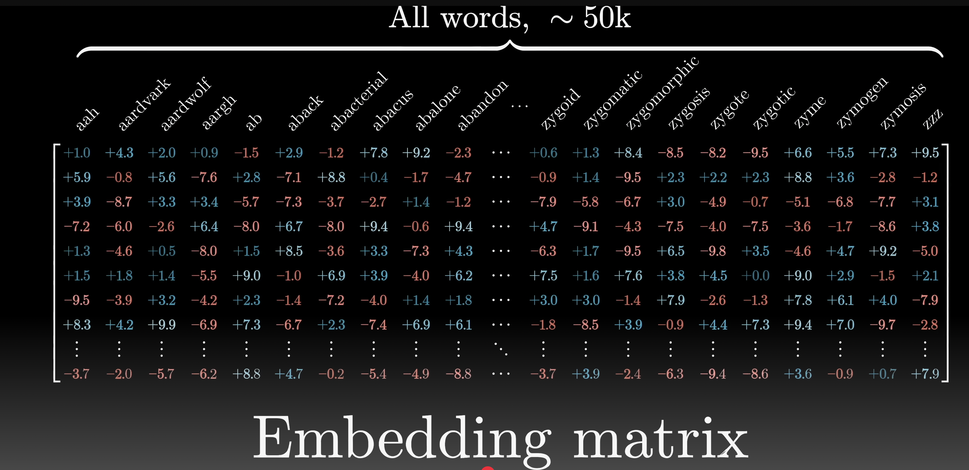
Applications to Large-Language Models
Video by 3blue1brown
Notes:
See autoencoder slide on how to achieve this

Slide 34
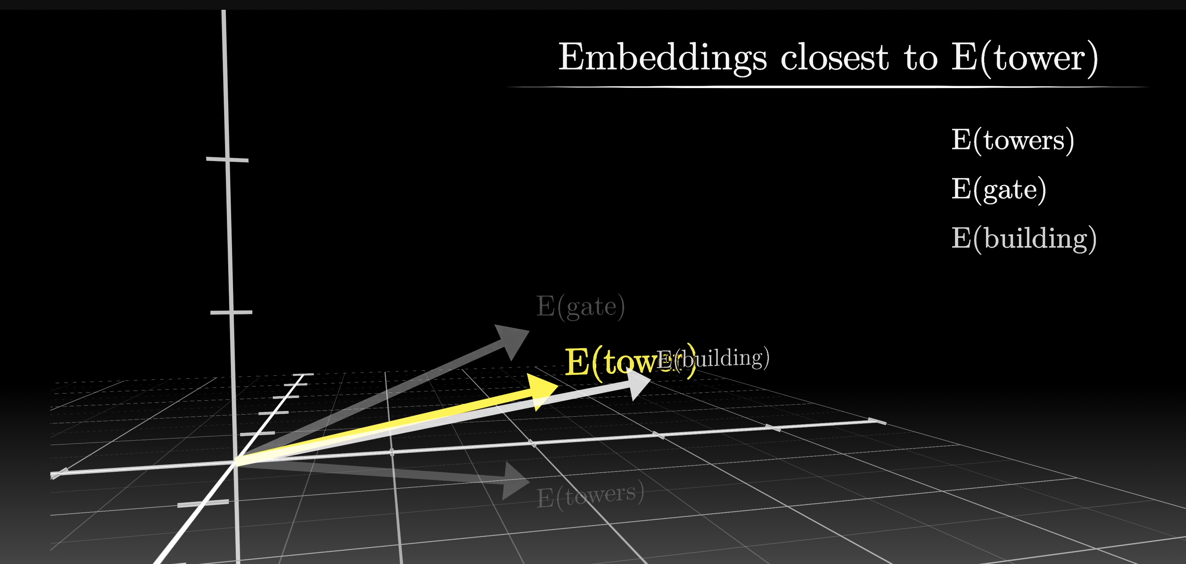
Applications to Large-Language Models
Video by 3blue1brown

Slide 35
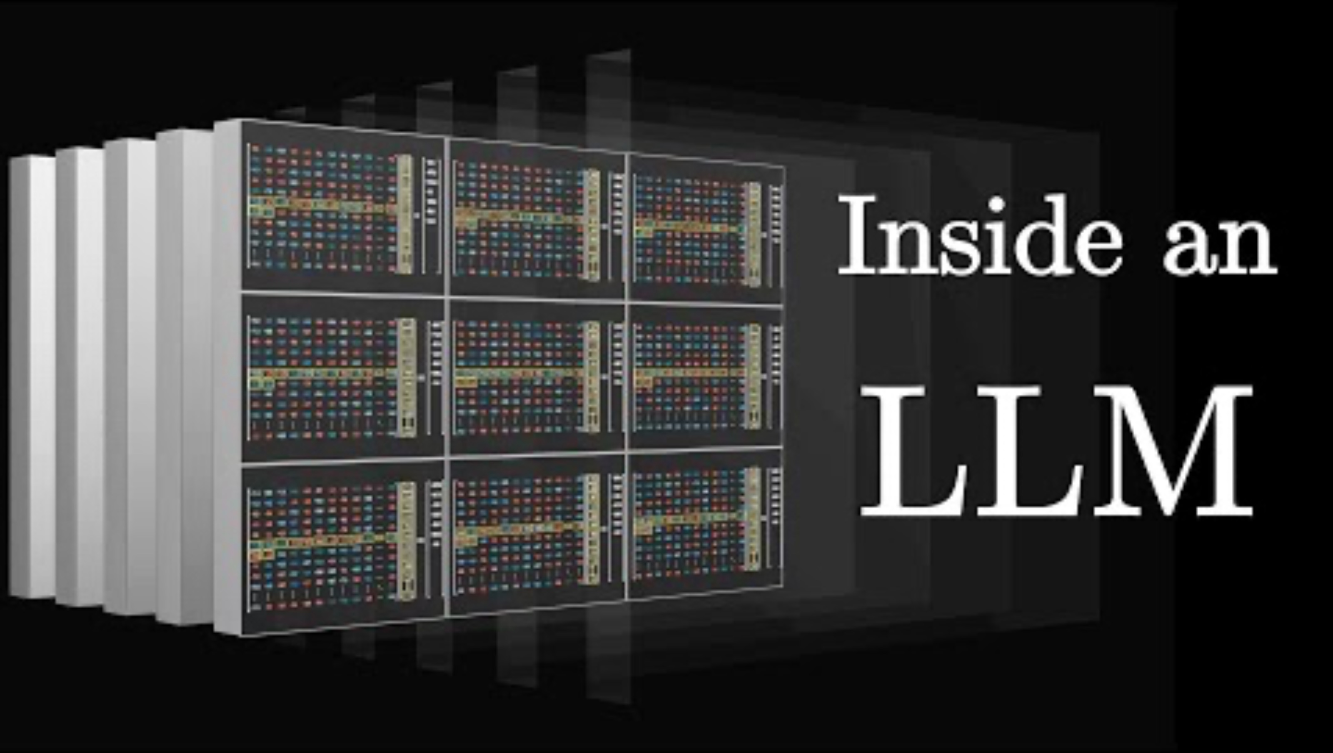
Applications to Large-Language Models
Video by 3blue1brown
Notes:
You can encode words as vectors, reduce dimensionality and then use it in a neural network
GPT-3 has about 12000 n umbers to encode words

Slide 36
Real life
In real life, there are no clear distinctions between unsupervised and supervised machine learning
You tend to use both
Or combine both (semi-supervised)
Notes:
You can encode words as vectors, reduce dimensionality and then use it in a neural network

Slide 37
Come back to the puzzle
You have a 5-liter jug and a 3-liter jug. How can you measure exactly 4 liters of water using only these two jugs?
Solution?
Now what if both jugs have the same base diameter (but different heights). Can you solve the problem using fewer steps?
Notes:
You can encode words as vectors, reduce dimensionality and then use it in a neural network

Slide 38
K means Clustering

Slide 39
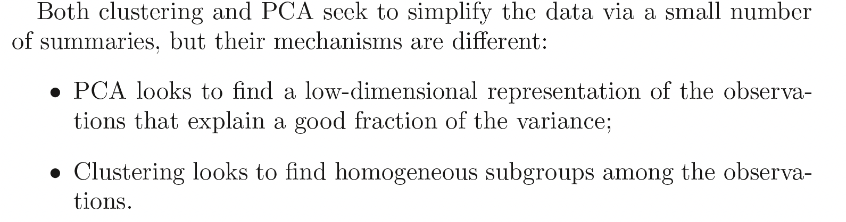
Clustering
Introduction to Statistical Learning in R

Slide 40
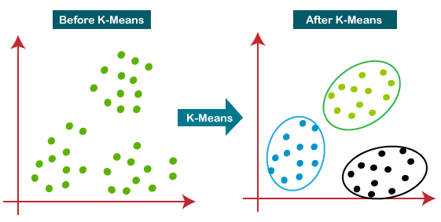
K-means Clustering
Slide courtesy Paul Fannon

Slide 41
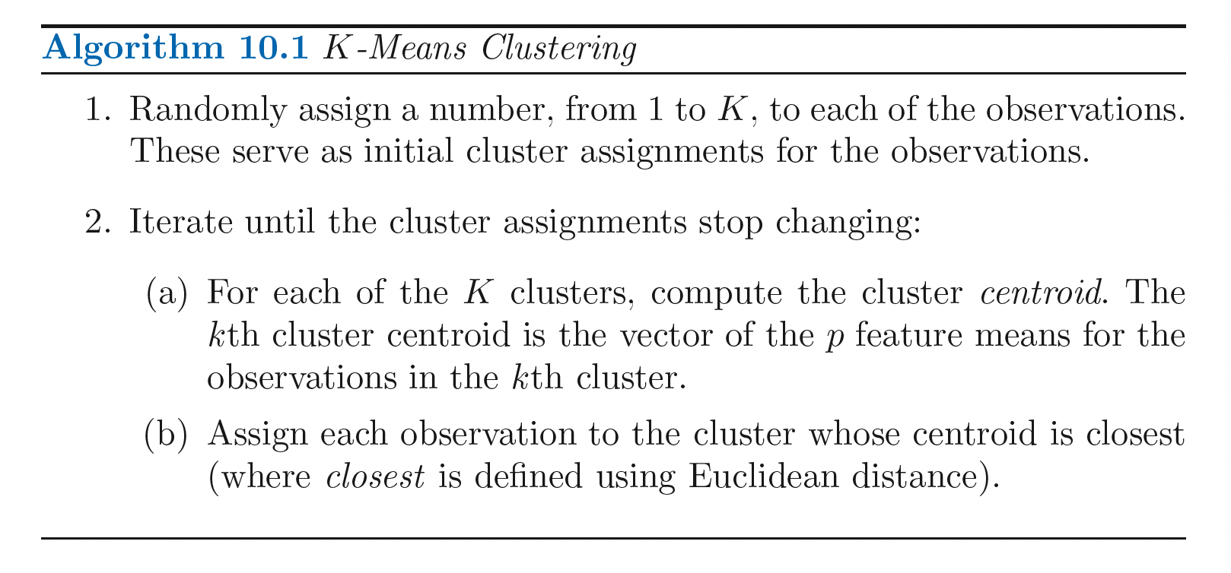
K-means Clustering
Introduction to Statistical Learning in R

Slide 42
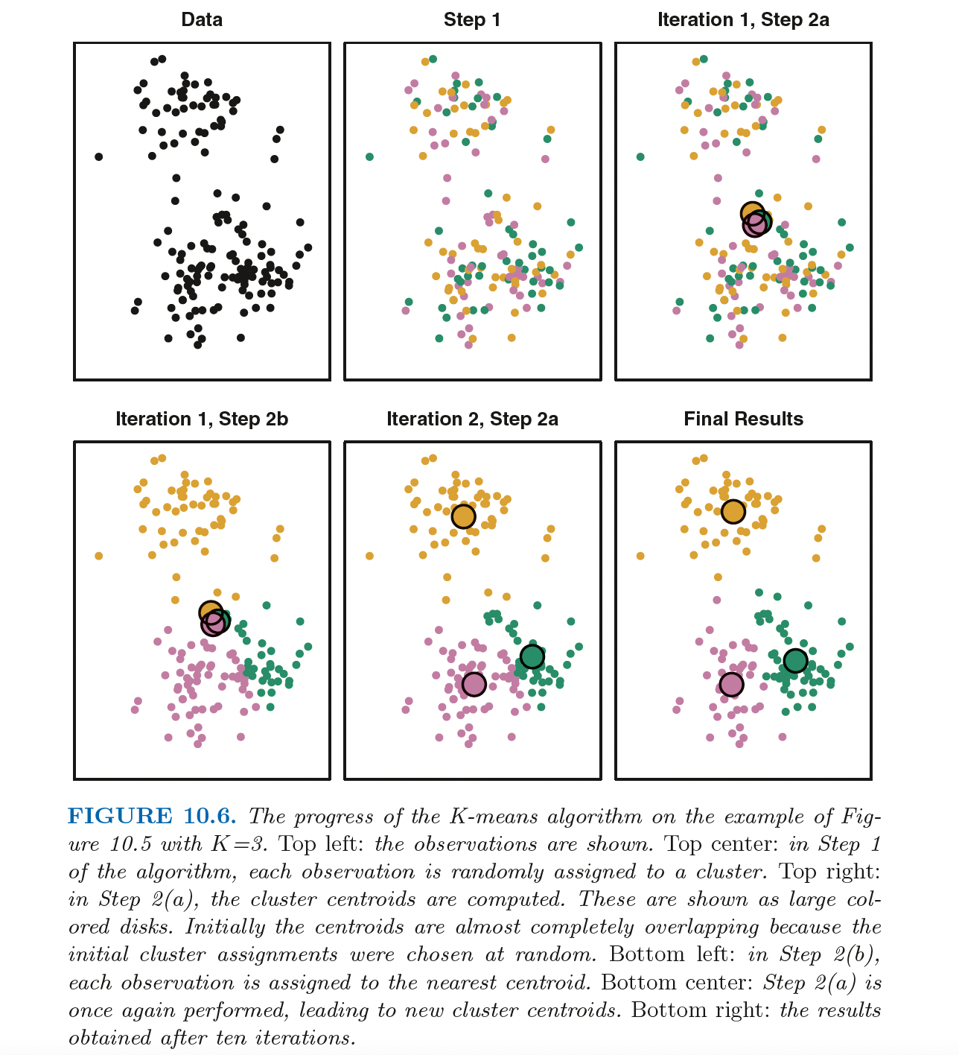

Slide 43
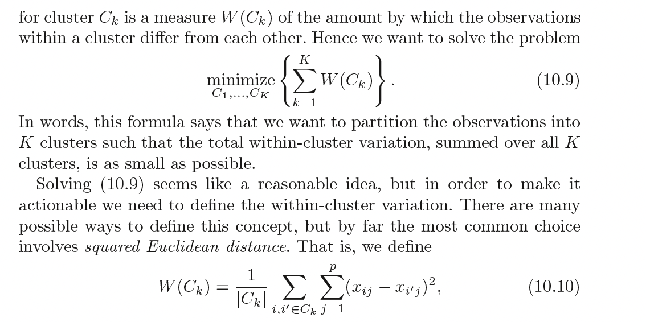
Introduction to Statistical Learning in R

Slide 44
K-means Clustering
1. Assign each data point to their closest centroid.
2. Work out the mean of each resulting cluster and make this the new centroid.
https://www.youtube.com/watch?v=5I3Ei69I40s&ab_channel=bitLectures
https://www.youtube.com/watch?v=R2e3Ls9H_fc

Slide 45
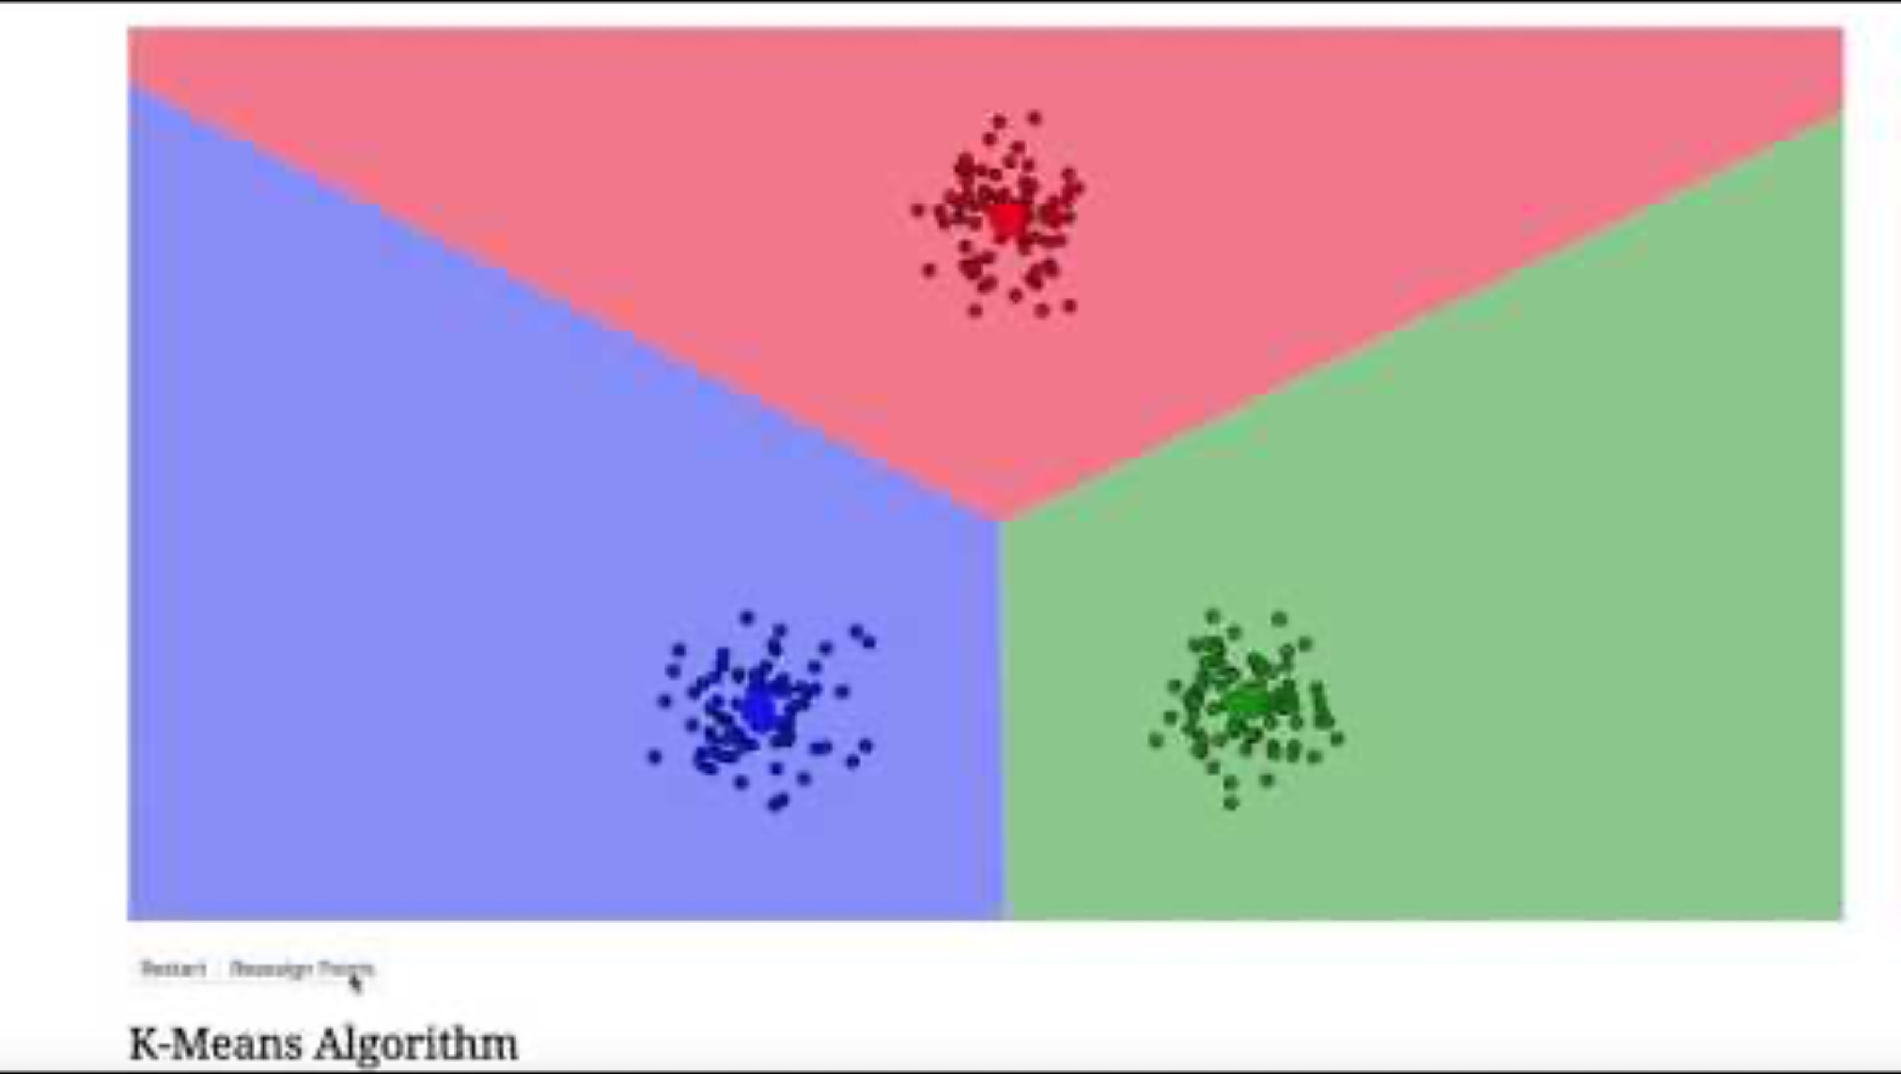
K-means Clustering

Slide 46
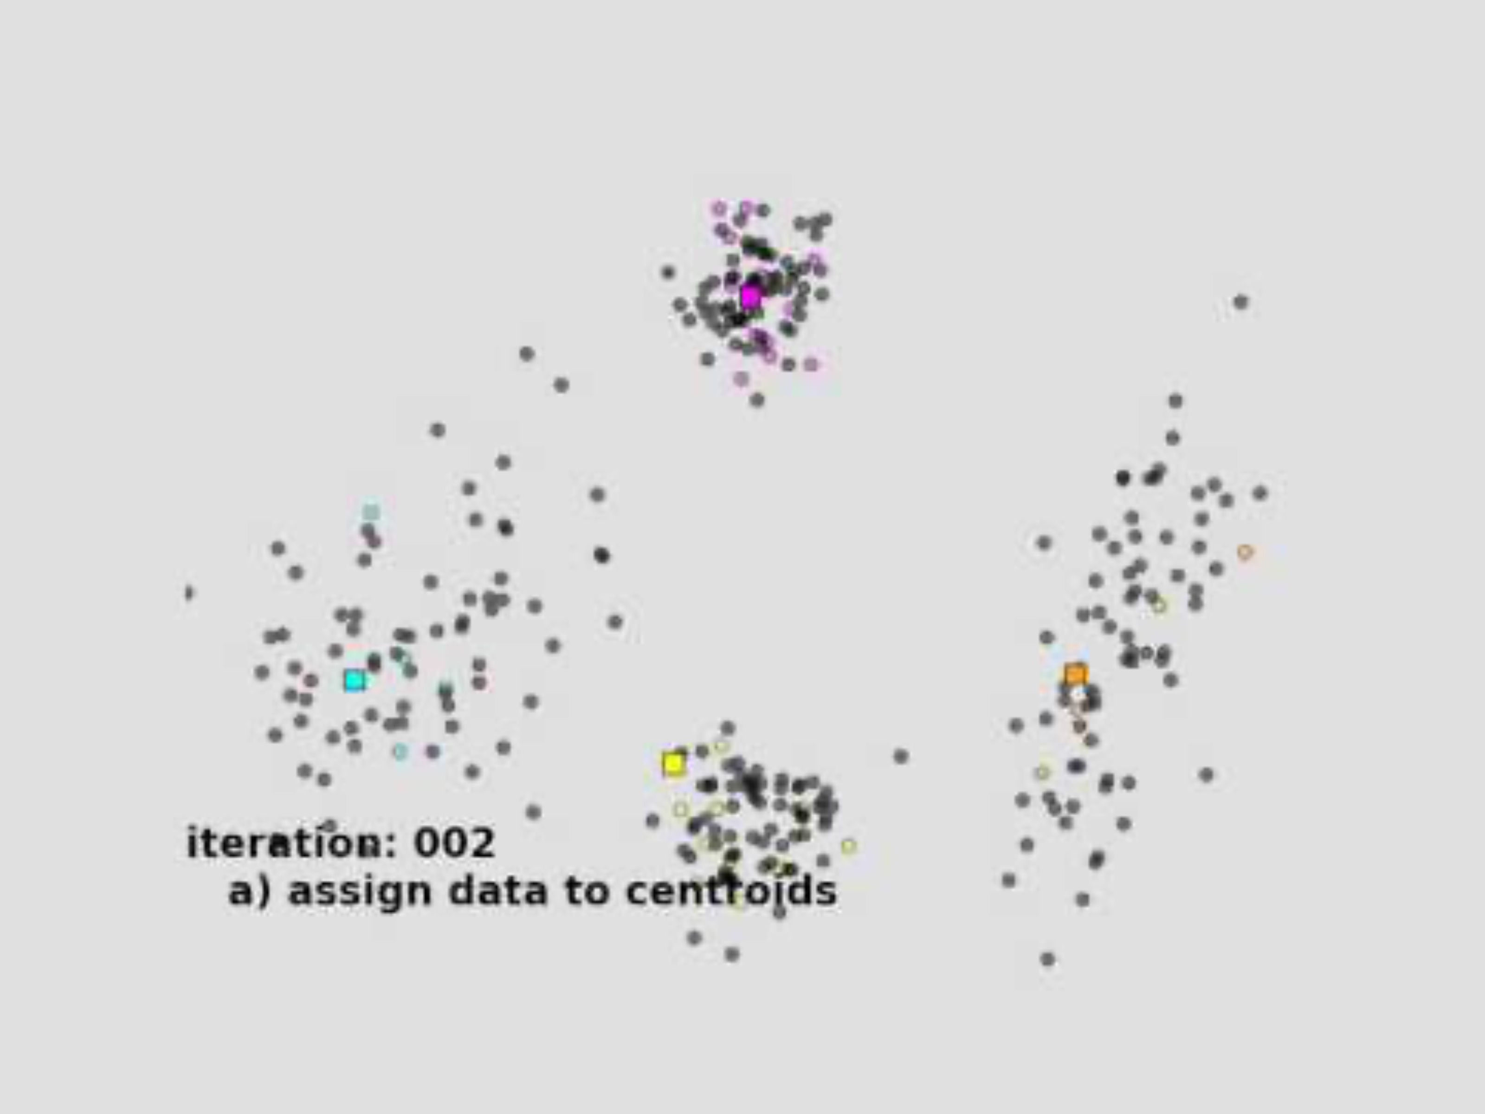
K-means Clustering

Slide 47
K-means Clustering
Can apply this to high-dimensional data (more than 2 variables/features)

Slide 48
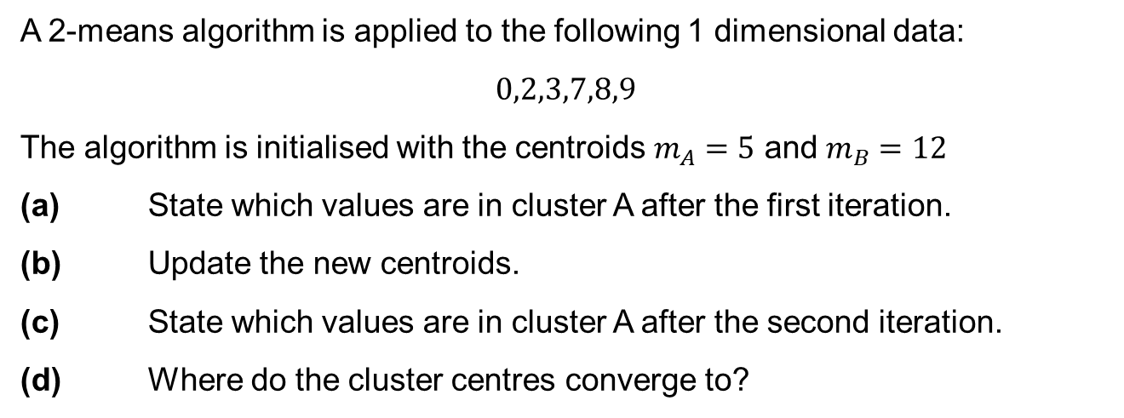
K means example
A 2-means algorithm is applied to the following 1 dimensional data:
$$0,2,3,7,8,9$$
The algorithm is initialised with the centroids $m_{A}=5$ and $m_{B}=12$
(a) State which values are in cluster A after the first iteration.
(b) Update the new centroids.
(c) State which values are in cluster A after the second iteration.
(d) Where do the cluster centres converge to?
Slide courtesy Paul Fannon

Slide 49
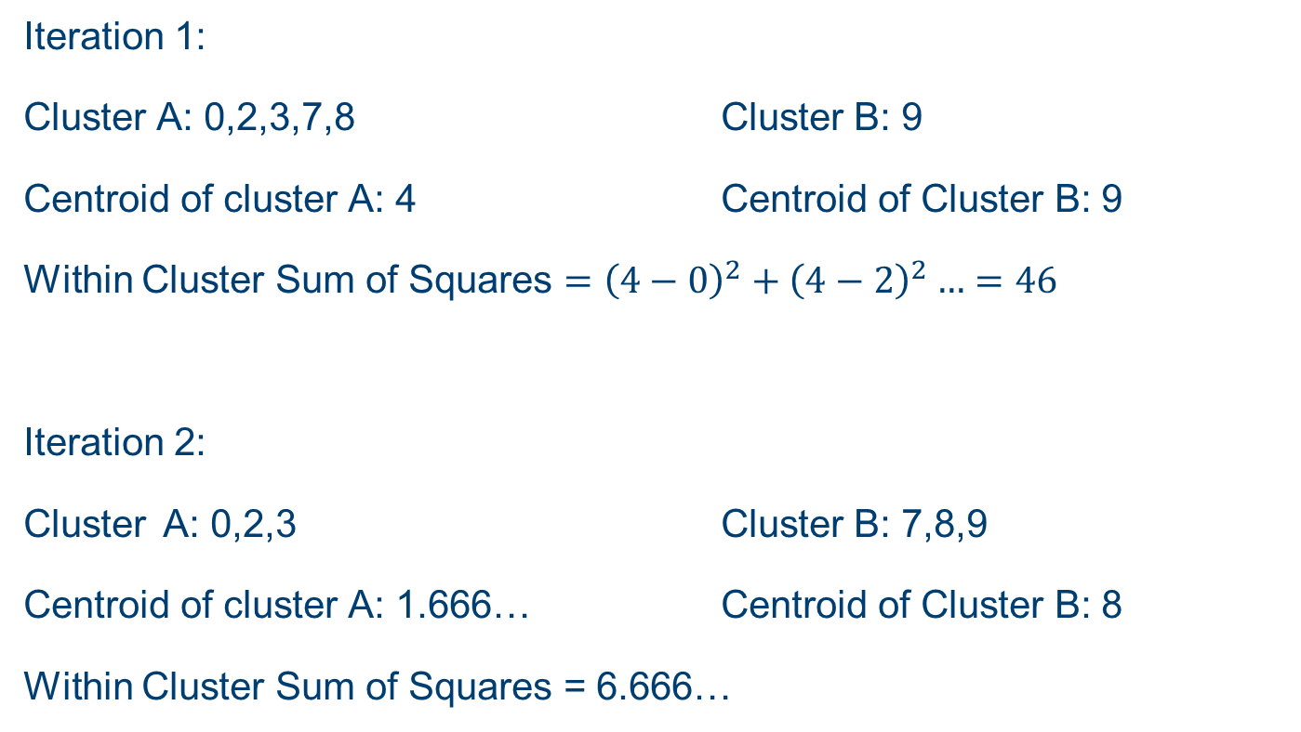
K means example
Iteration 1:
Cluster A: 0,2,3,7,8 Cluster B: 9
Centroid of cluster A: 4 Centroid of Cluster B: 9
Within Cluster Sum of Squares $={\left(4−0\right)}^{2}+{\left(4−2\right)}^{2}…=46$
Iteration 2:
Cluster A: 0,2,3 Cluster B: 7,8,9
Centroid of cluster A: 1.666… Centroid of Cluster B: 8
Within Cluster Sum of Squares = 6.666…
Slide courtesy Paul Fannon

Slide 50
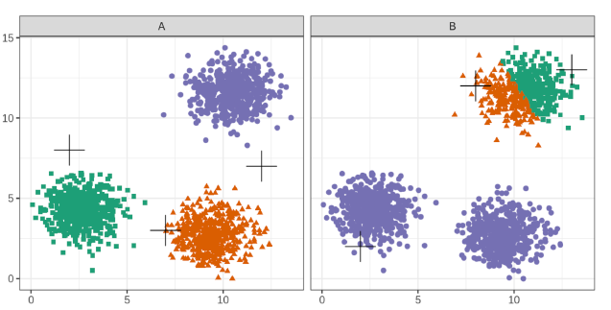
Choice of initial centroids
Slide courtesy Paul Fannon

Slide 51
Choosing k
Slide courtesy Paul Fannon

Slide 52
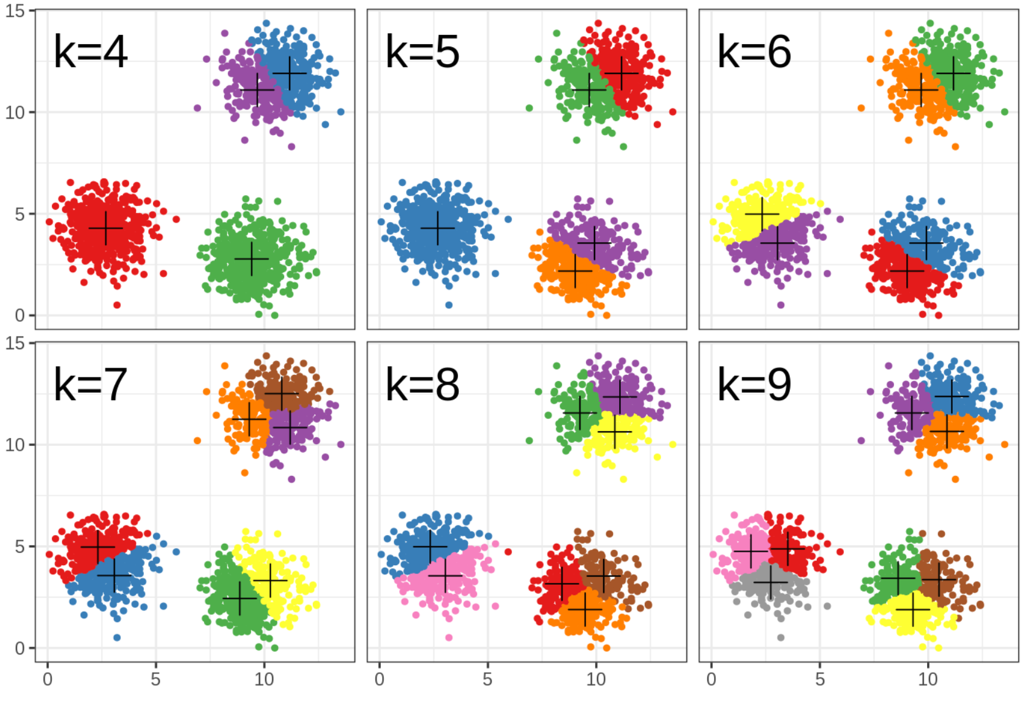
Choosing k
Slide courtesy Paul Fannon

Slide 53
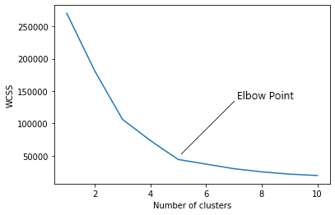
How to find the value of K
Slide courtesy Paul Fannon

Slide 54
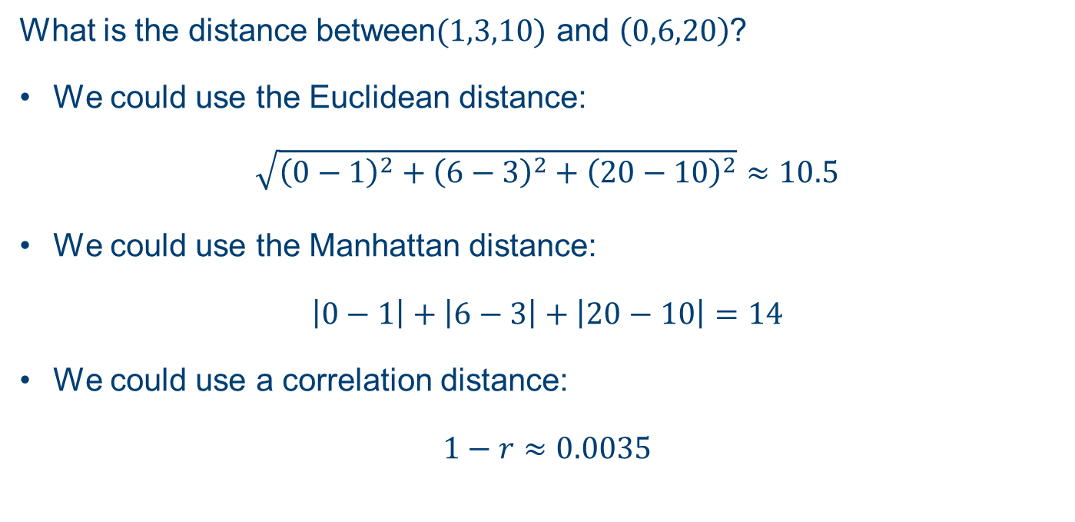
Clustering Distances
What is the distance between$(1,3,10)$ and $\left(0,6,20\right)$?
We could use the Euclidean distance:
$$\sqrt{{\left(0−1\right)}^{2}+{\left(6−3\right)}^{2}+{\left(20−10\right)}^{2}}≈10.5$$
We could use the Manhattan distance:
$$\left|0−1\right|+\left|6−3\right|+\left|20−10\right|=14$$
We could use a correlation distance:
$$1−r≈0.0035$$
Slide courtesy Paul Fannon

Slide 55
Resources
https://github.com/neelsoumya/public_teaching_unsupervised_learning
https://www.statlearning.com/

Slide 56
Hierarchical Clustering

Slide 57
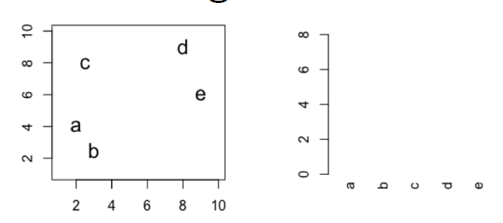
Hierarchical clustering
Slide courtesy Paul Fannon

Slide 58
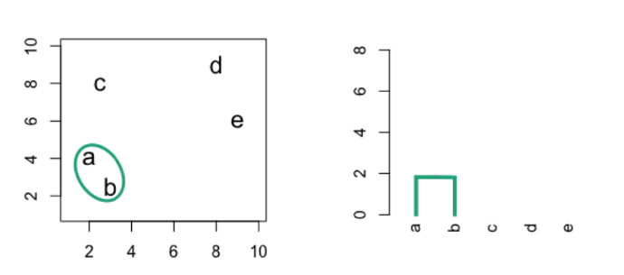
Hierarchical clustering
Slide courtesy Paul Fannon

Slide 59
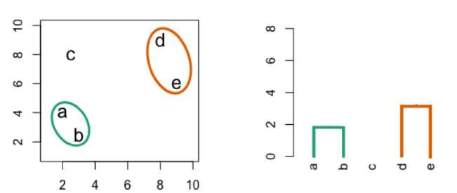
Hierarchical clustering
Slide courtesy Paul Fannon

Slide 60
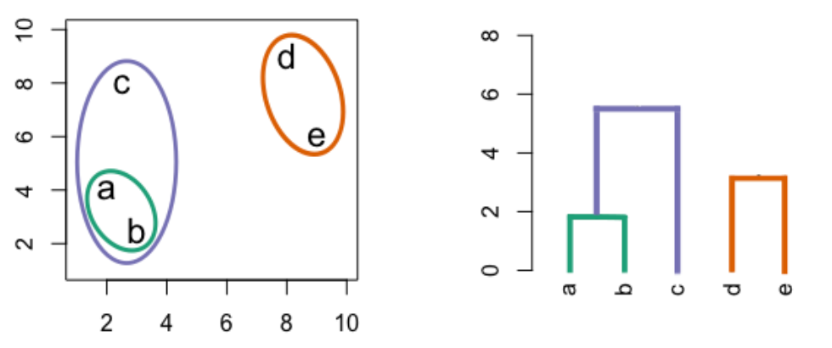
Hierarchical clustering
Slide courtesy Paul Fannon

Slide 61
Hierarchical clustering
Slide courtesy Paul Fannon

Slide 62
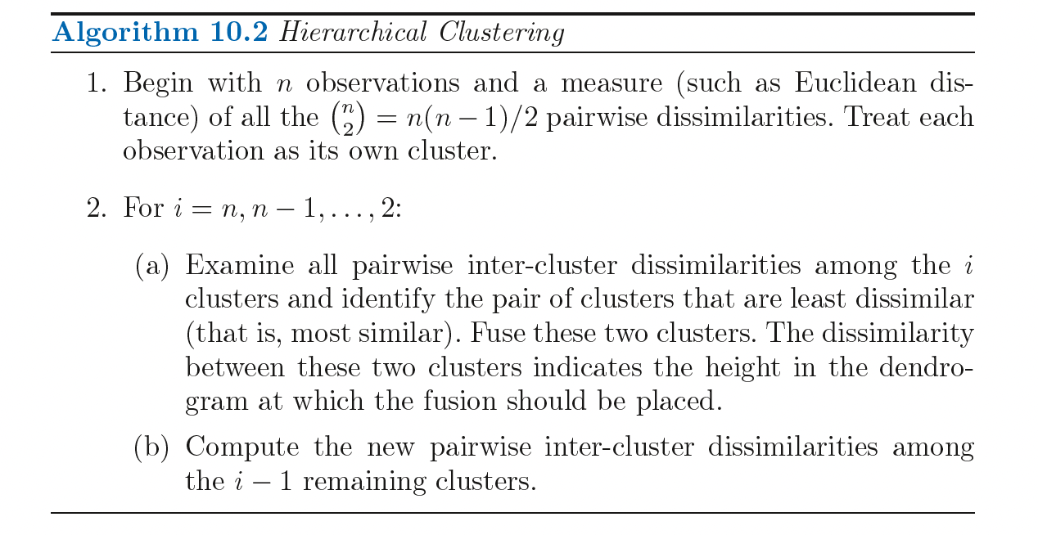
Hierarchical clustering

Slide 63
Dissimilarity measures
Euclidean distance
Correlation based distance

Slide 64
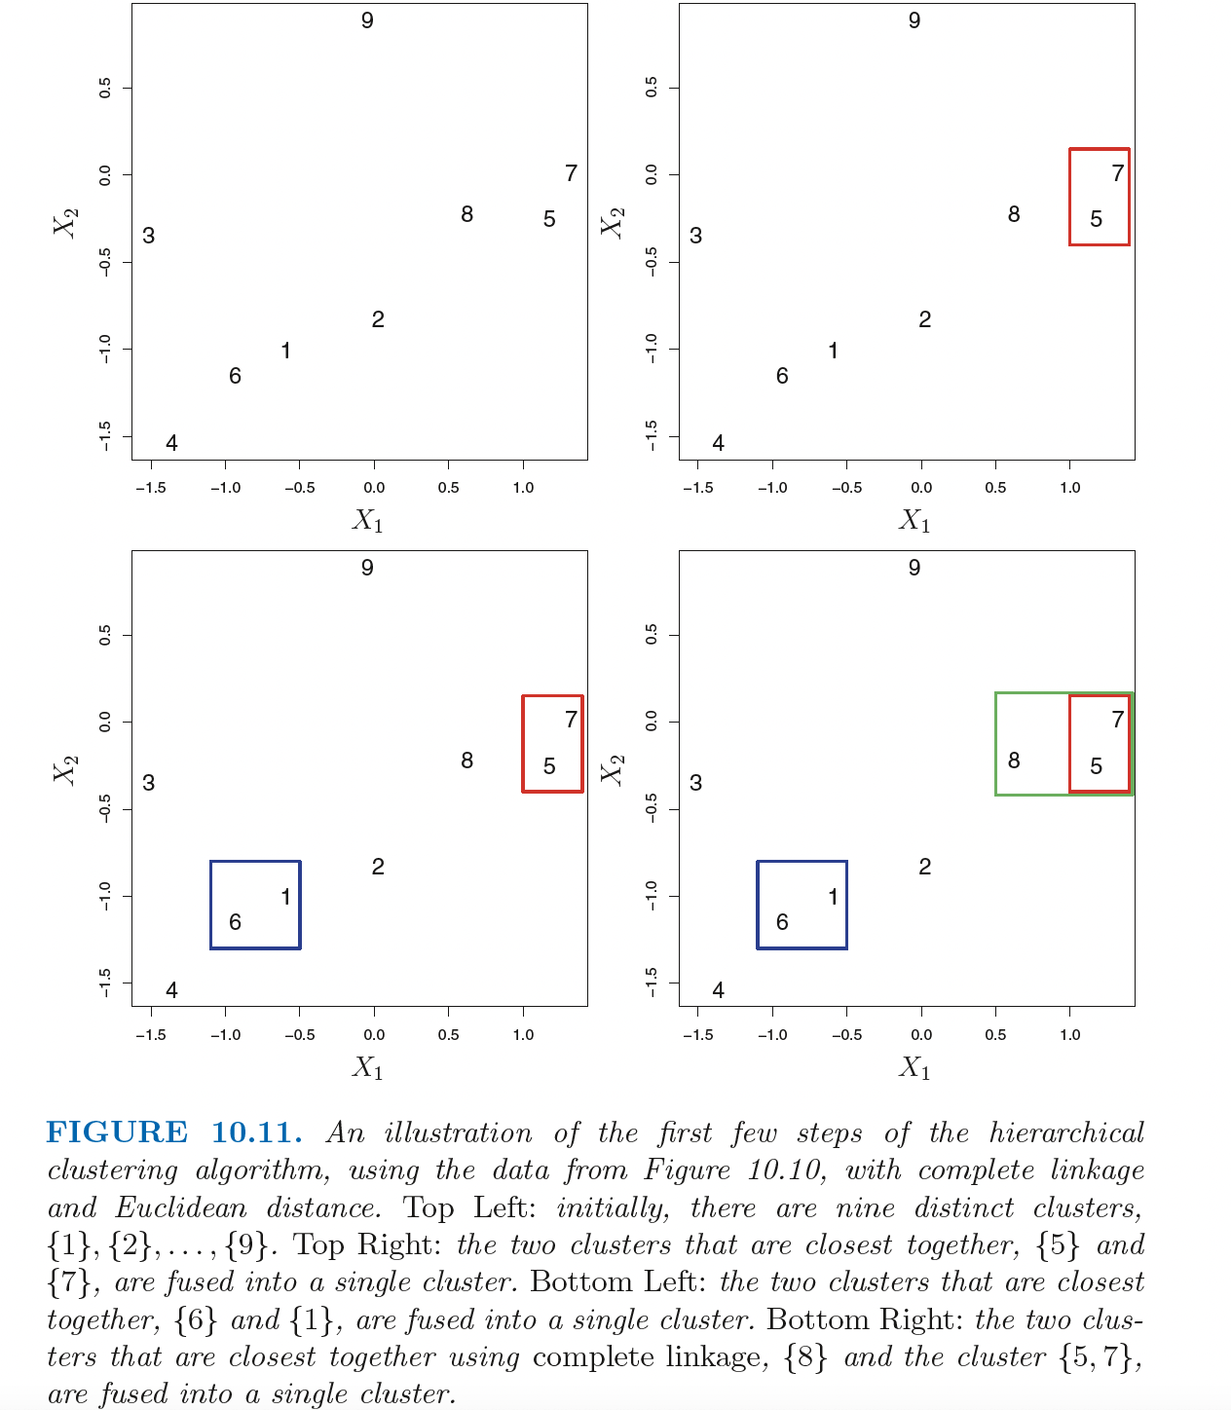
Dissimilarity measures

Slide 65
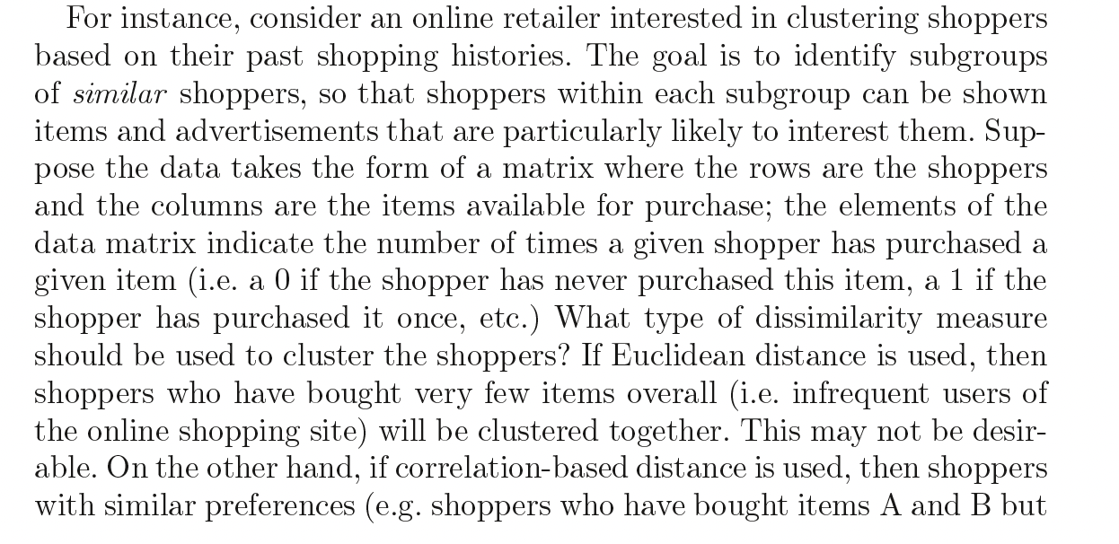
Dissimilarity measures

Slide 66
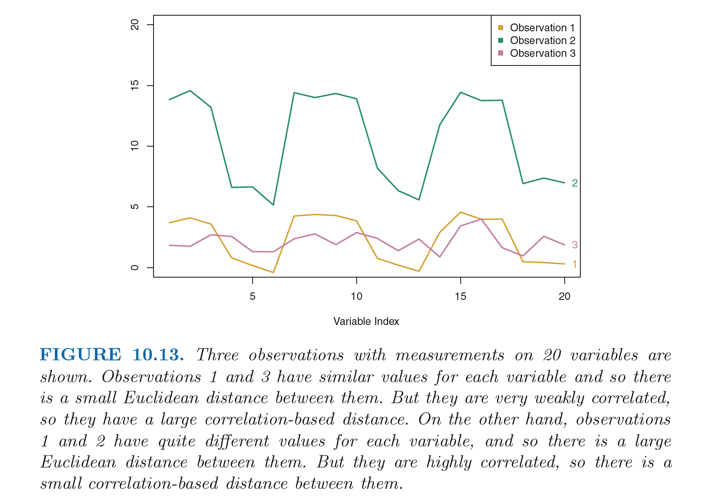
Dissimilarity measures

Slide 67
Dissimilarity measures

Slide 68
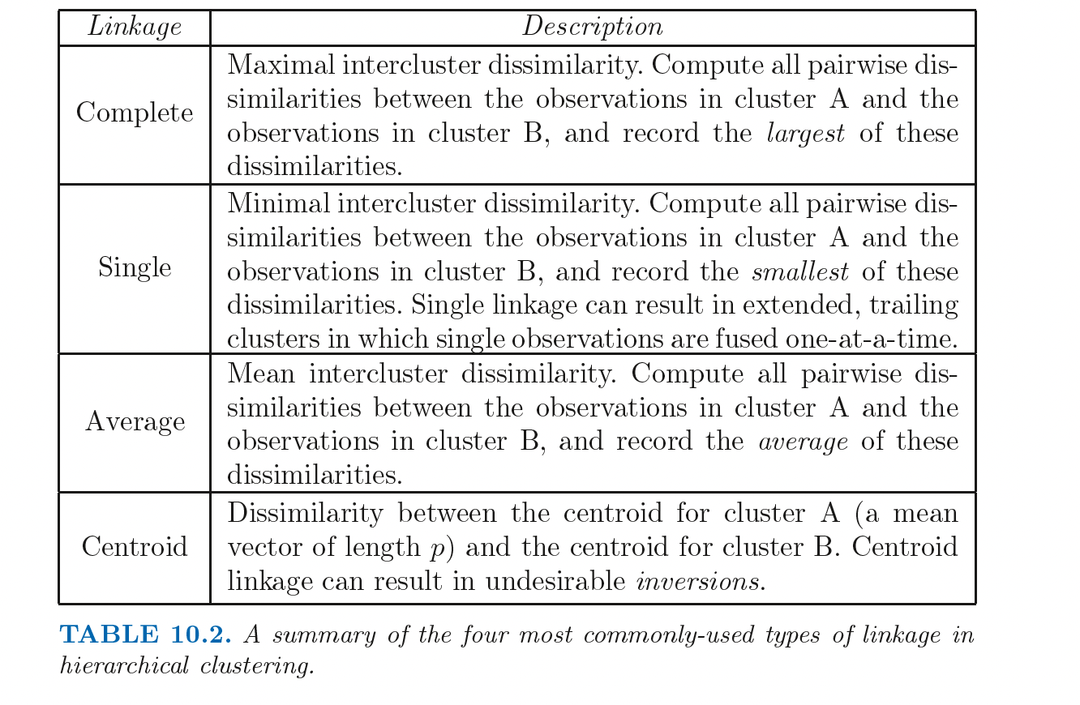
Dissimilarity measures

Slide 69
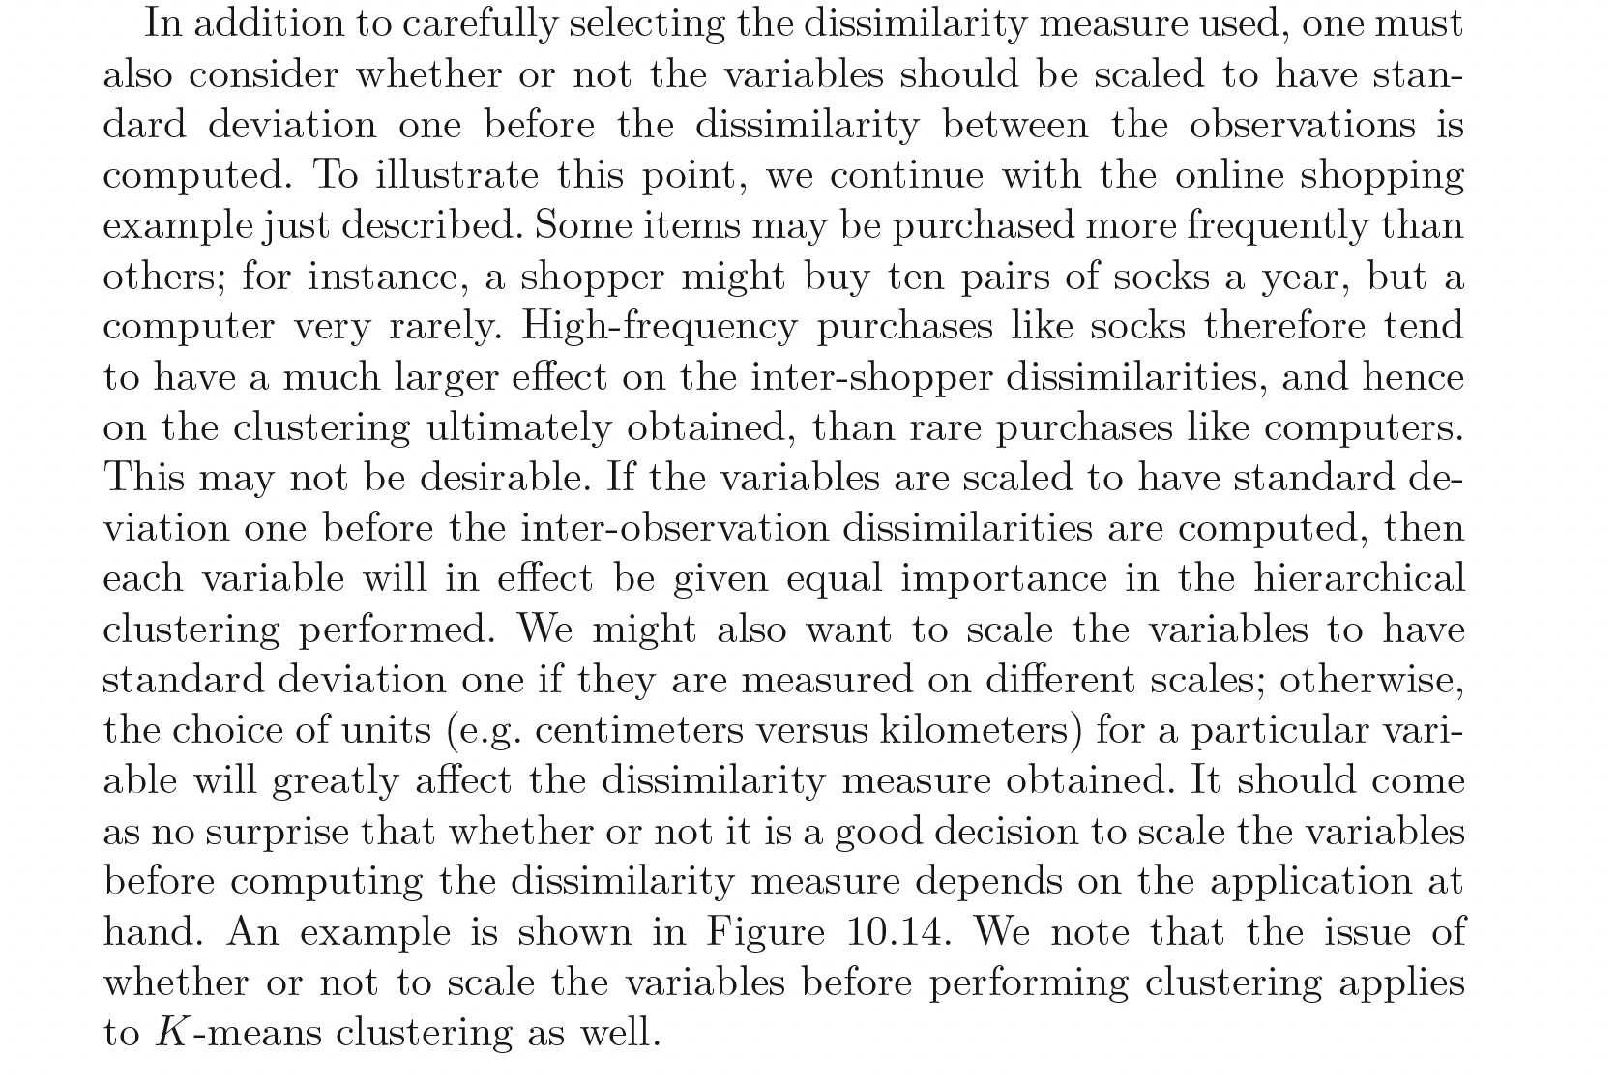
Scale variables/features

Slide 70
Hierarchical clustering
Three types in common usage
Single linkage – look at distance between nearest neighbours
Complete linkage – look at distance between furthest neighbours
Average linkage (UPGMA) – look at average distances between al possible pairs in each group.

Slide 71
Hierarchical clustering example
For the data set 7,10,20,28,35 perform hierarchical clustering using
Single linkage
Complete linkage
In each case plot the dendrogram to visualise it.

Slide 72
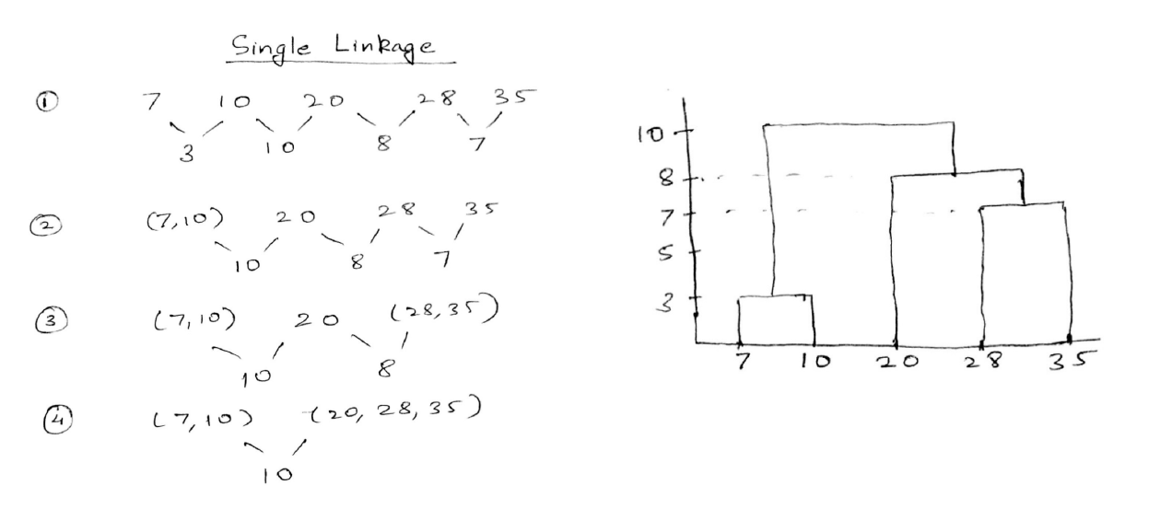
Hierarchical clustering example
Slide courtesy Paul Fannon

Slide 73
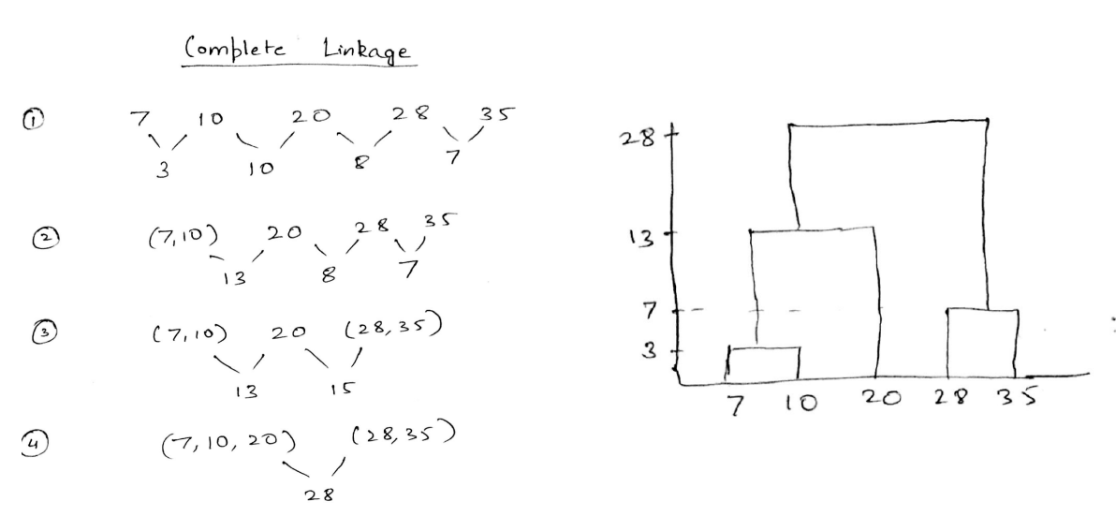
Hierarchical clustering example
Slide courtesy Paul Fannon

Slide 74
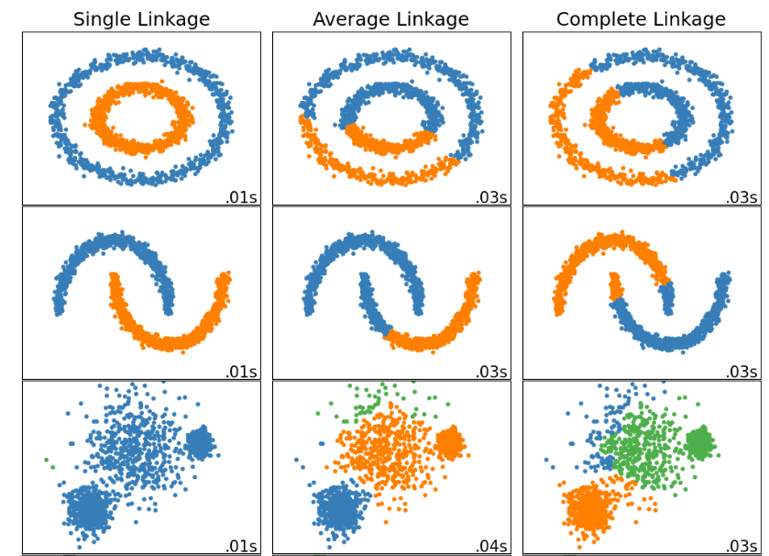
Comparing Hierarchical Clustering Techniques
Slide courtesy Paul Fannon

Slide 75
Comparing k means to Hierarchical
Advantage of k means over hierarchical:
Faster computationally.
Does not require choice of linkage.
Advantage of hierarchical over k means
Does not require number of groups to be known in advance.
No random seeds so more reproducible.
Does not assume spherical shape.
Slide courtesy Paul Fannon

Slide 76
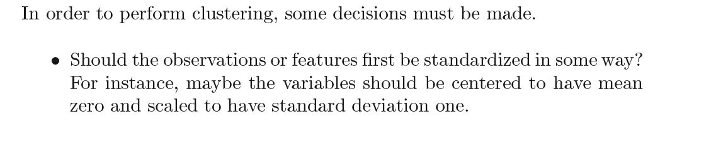
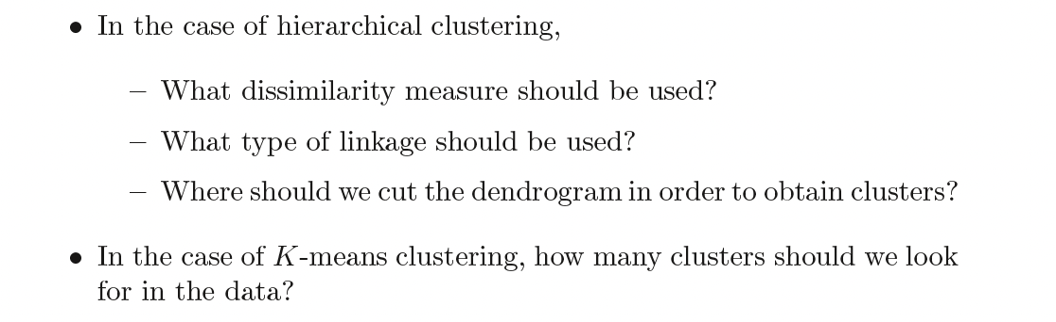
Decisions

Slide 77
Validating clusters
Validate clusters in external dataset
Hypothesis generation

Slide 78
Interactive explanations
https://mlu-explain.github.io

Slide 79
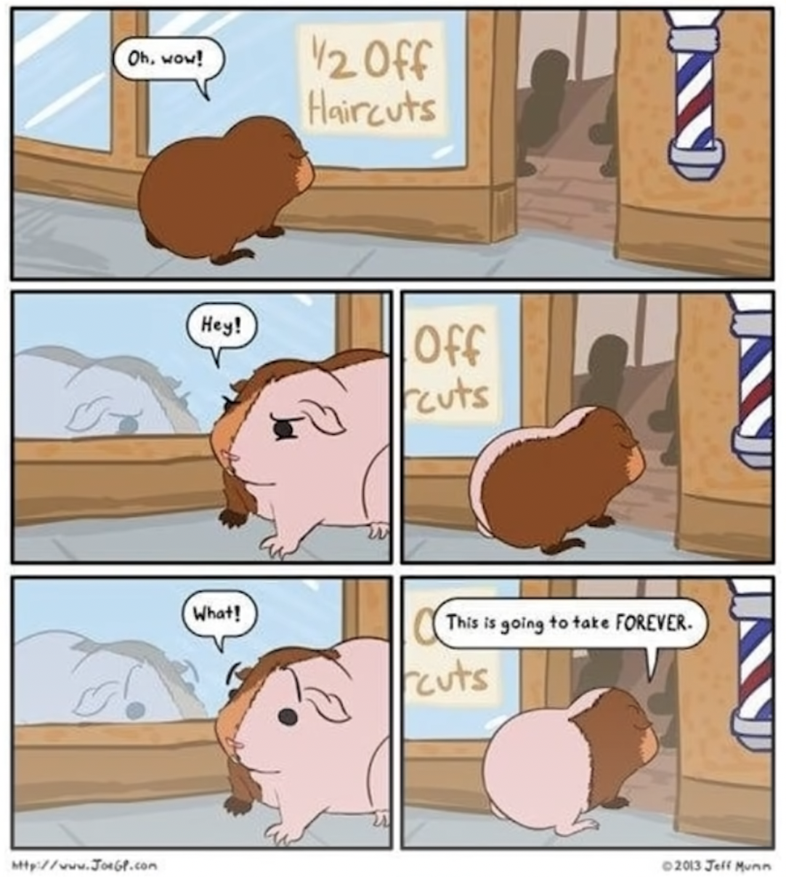
Validating clusters

Slide 80
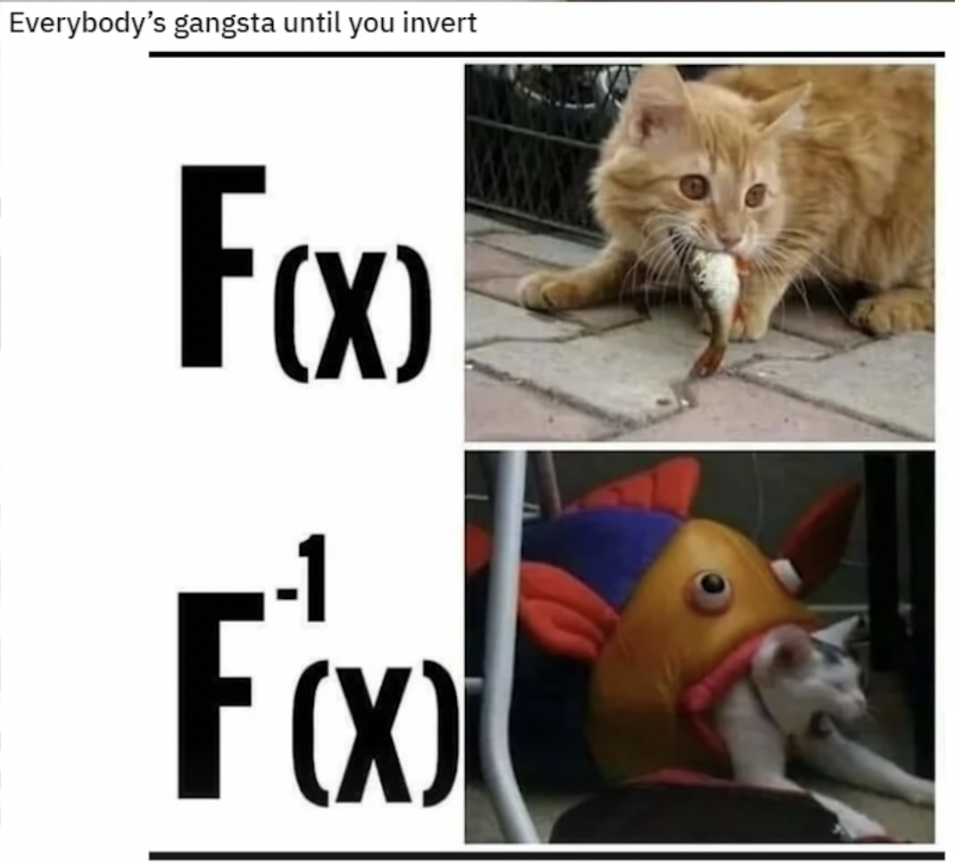
Validating clusters

Slide 81
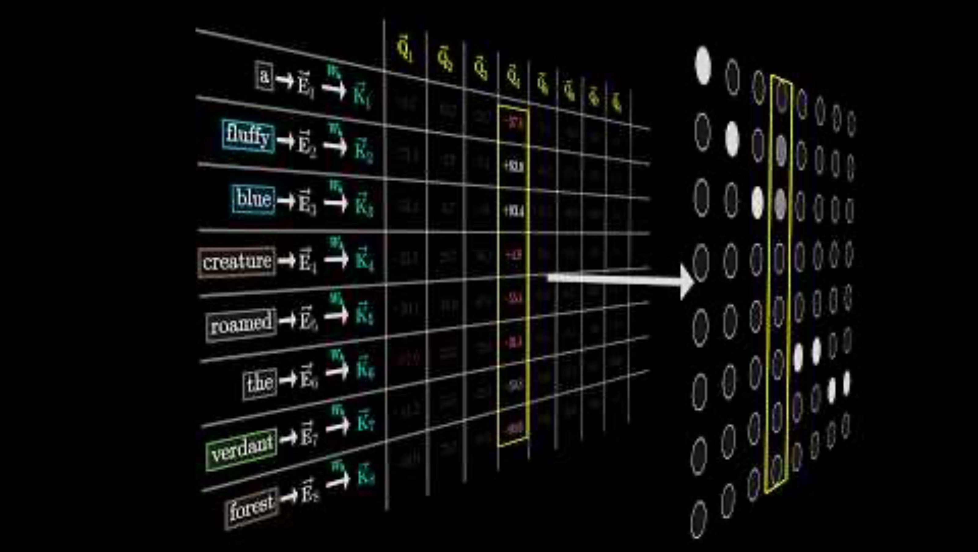
Validating clusters

Slide 82

Supervised Learning - Classification

Slide 83

Supervised Learning - Classification

Slide 84

Unsupervised Learning

Slide 85

Unsupervised Learning

Slide 86

Unsupervised Learning

Slide 87

Unsupervised Learning

Slide 88

Reinforcement learning
The inputs must be a sequence of three numbers.
For example $\left(2,4,6\right)$ works.
Find more examples that work.

Slide 89

2021 Exam (SUPERVISIONS)

Slide 90


2021 Exam Question

Slide 91

2021 Exam

Slide 92
Principal Component Analysis

Slide 93
Principal Component Analysis
A great way to extract the important information from highly dimensional data
Finding combinations of “real variables” which extract the majority of the useful information from the data.

Slide 94

Principal Component Analysis

Slide 95

Principal Component Analysis

Slide 96

Principal Component Analysis

Slide 97

Principal Component Analysis

Slide 98

Principal Component Analysis

Slide 99


